Slide 1
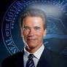
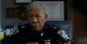
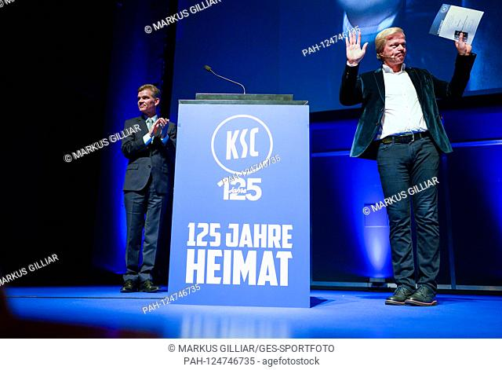
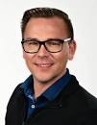
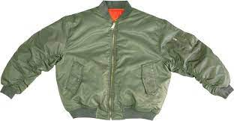
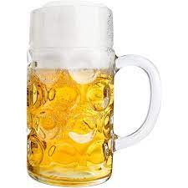


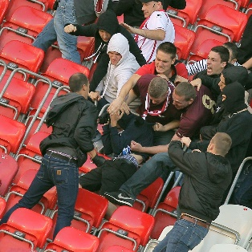

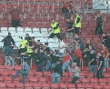
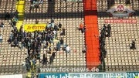
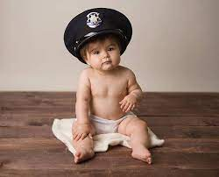
FBI
partner
develoment
1997 October MAINSSTREET
SQ.PREA.§187
Foster City, California
Jason
Philip
“I fucking left, I was on there 2 year 1995/6 at night 2 hours”
Marlin Blvd
Logical 2014 41.CPVA.TERMAINSOTR.JOEPHSE.cisoc.motoring
2014 IMPORT “Bomber” Sexton (cpva recipenet),IMPORT cpva sender
TORT-I
SQ.AIRFIELD.COLEMAN
morgen freeman; naratore VP Germany
TORT-1 Singenr; backup AfD block KCS
DEA(herion,oli;danile -> badner-lied; TORT-1)
CIVIL CODE(WW2 National Anthem, Vom Rastatt to Mannheim, Deutschland Duetsha ueber alles)
Phil.JFK.MLK(philipsburg)
CPVA
HOMCE:MAYR:.St. Nick; hitler visitied liedolshaeim acker
visa
TERAMATOR:JOESE:ATOMFACTORY:SLIDES:IPS: ALIGNMENT OF
POWER, STANFORD 41 lignting bolt powepont
SALES
Russheim(41.Russians),CHECKPONCE(Kdwe,Zoran INTERP PENTONG LOVLACE ID,goran)
NOTE: 10 Minutes Doucmentation (druck)
CIVIL CODE VIOLATIONS,
WAR CRIMES,
CPVA (Personal)
Liedolsheim
8:43AM 1 hour 7:43AM
27Y 2023
LARRY
“Bomber”
!white
41.asusemd:MONPOLOY:CAR/;IBM
ANGEL A MERKL: VOTES[stadium]
DAMILER CHAIR
IBM CHAIR
Rage against the machine
MAINSTREEET(Hochstetten)
Blond Wold Cum Obama Dick Microphone
Horny Brneete
Classroom
x
POLCIE:SIRENS:8:15
VP GERMANY; maro.father FEDERAL COURT
Ger,am Thanksgiving(Phinst Tunie Liedoelsheim)
Thankvifing Baskes KING.WORRMS( 2009
HOMCE:IS_A-BELL; killed a tuckey; HOMCEI:TURKEY
VP GERMANY: VOTES
Linkenheim
Eggenstein-Leopldshafen
Karlsruhe
COURT RASTTT
- LISA, gheoh(kito,who is got;micheala)
Wyland trucks;stop; rast(stadt) rest town; LKW/CDL

Slide 2

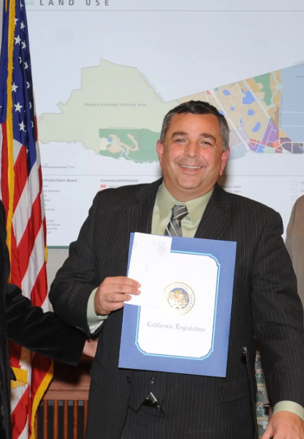
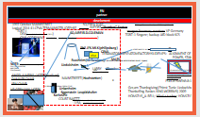
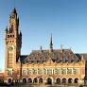
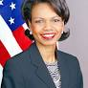
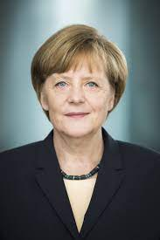
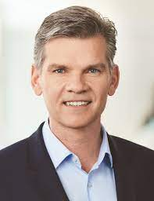
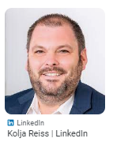

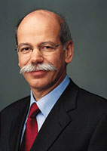
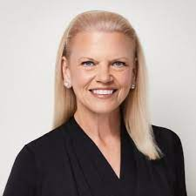
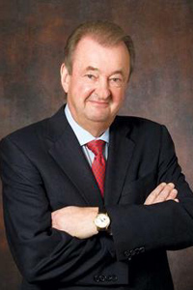
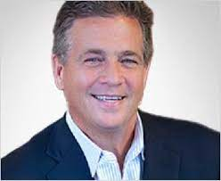

FBI
partner
development
CPVA.SQ.§187.PREA
v2.FBI:KIDNAPPING
“I fucking left, I was on there 2 year 1995/6 at night 2 hours”
CHART
GERMANY
UNITED STATES
US President
Mayor Dublin
INTERUPTS
Sectary of State
Dr. Condelizza Rice
EUROPE
WAR IN YUGOSLAVIA
ASIA
DESER STORM
WWI
WWII
CALL YOU RICE(atomclock(tim,apple-seed)
Its: the ss, with small penis and no cum. Anymore. SAP
She is not pickup up the phone or visitation.
[x] no
!WHITE
[x] no
Visa Bridge
California Governor
POLCIE SIRENS: 8:36AM
mopay
We evaluated that compnay
SS: Reiss, Brodesser, visa:Petersson
2014 CPVA
MONPOLOY(Damiler Ag)
MONOPOLOY(IBM)
WWI,WW2
CAR-COMPUTER
POLICE SIRENS:
8:26AM

Slide 3

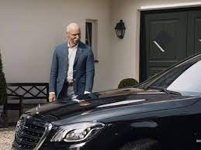
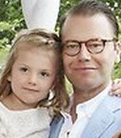
FBI
partner
development
1992
I stayed
OTTO-HAHN-STR
DEA(lsd).KING.TERMAON.JOSPHE.sexton
HOMCE:LUX:COINSOTN(fortst) Woflgangs house and car
1992
HOMCEI:LUX:VHS
Steve: He has a trans am,
with a golden tailgaite
Two baby benz, and covertables, same colr as wife
1992 Patchwork: Elke, Densie,“tootsie” and Myself (sega,gamegee 300DM KING.QUEEN.WORMS) from Mark(us): 300DM budget KING.QUEEN.WORMS
Mark(us): Irena von Solms(worms)Dutches
Malon zrur Niederwegs
FRANFURT,Huesenstame (OTTO-HAHN-STR

Slide 4
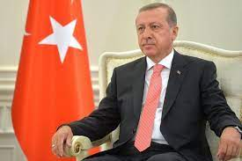
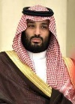
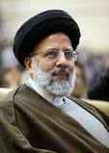
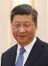
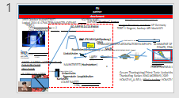
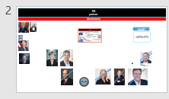
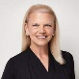
FBI
partner
development
2023
CPVA.SQ.§187.PREA
v2.FBI:KIDNAPPING
CHART
Go may ha had SQ.CDCR
God may have taken a person for 45 in kindergart to explain things
INTERUPTS
[x] no 0.1
20% zkm(art).TORT-1.stopher
Ocupancy 20% nonPoliceTRX
Alg FIRST phil(kim) I don’t even watch tv
80% occupancy
0.1
Note: Level
Phil.JFK.MLK(gohceo(Dell(client.vodaphone.souhtafice.ML(iran)SALES))
!AVABILTIY.!FACEBOOK.(dev-ops).kubernetes.carlos.24x7(frist shift!hidden shift)
0.1
!0.01
Al kaida ->
robert
IMPORT FBI:WMD al kaida 3-brothers Mex/Iran,granfahter,02
HOMCI:JESUSE(apple.jeuse)
Kartelrecht(breakfast): St. Nick.Nikis papershot
Zoll(Lisa,Boner): VIRING.MARY(stephanie AUSCHWITH.St. Francis.Ange8th.8th
(delta)
Cognitive.ibm
“Jobs” iron house trail
FBI:WMD Robert i.e.

Slide 5
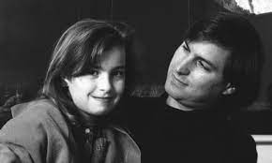
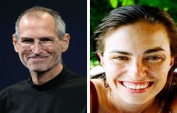
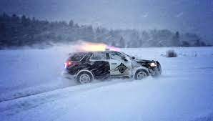
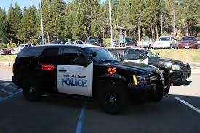
FBI
partner
development
ATOMCLOCK
Quartz Circle
2014 HOMICE:JEUSE: SPANISH:VIGINAI:MARY.apple
Dublin
Mayor
JFK.VOICE
IPX Stadium High School - Dublin
2013
https://www.jfklibrary.org/asset-viewer/archives/JFKWHA/1961/JFKWHA-004/JFKWHA-004

Slide 6
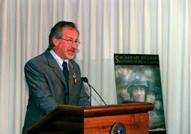
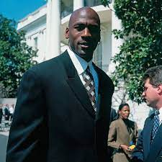
FBI
partner
development
Pentagon: Steven Spielberg
Whitehouse: Michael Jordan

Slide 7

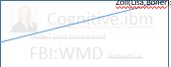
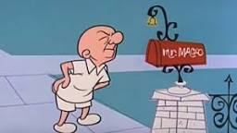
FBI
partner
development
Student,intern
1988,1990-2014
0.01
Al Zollar, Lotus
Al Zollar, Tivoli
Where was I?
CPVA.SQ.§187.PREA
v2.FBI:KIDNAPPING
1D8723 calc.(41). To have the person live like that
Soap:Envelope
x/y FBI:TERRORISM
(known) not to live like that
Apple !mail !HOMCIDE:GHOST(PHANTOM):ATOMCLOCK(tim); v2
morgan freeman email movie
Where was I?
Roth: to define traqulity; nonPoliceCTXLogical
Roth.DEA(herioin)
Tranquility
Peace and Quiet
0.1 0.1 41.DEA(herion) to take herions to have people and queit SFO.ARIPORT. Left(chinese perons kidnapping)
right( herion bags shipping; !bycicel
[x] no
Bazook gum; wife and Sunday; hanging mat
matenee

Slide 8
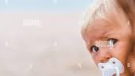

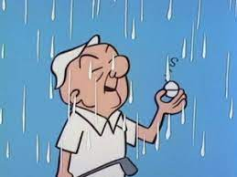
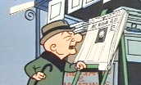
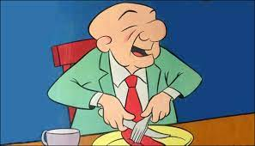
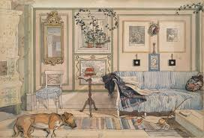
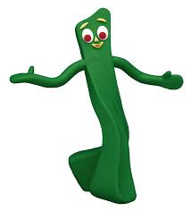


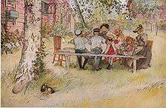

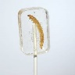

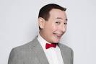

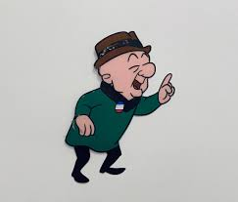
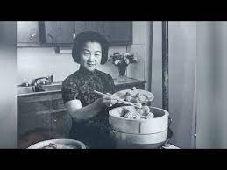
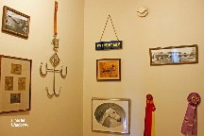




FBI
partner
development
v2.FB:KIDNAPPING
DEA(§Possetion).WW2
DEA(§Possetion).WW2
2013 !CPVA
Find tranquility.!ABABILITY
.!41.!CIVIL CODE
!HOMICIDE:IS-A-BELL
1996 8/8th Isabell Rampf
Tranqulity -> Tequilla
HOMCIE:IS-A-BELL:HOCEM:KUSTLS:HOMCE:JEUESHOCENM:TANVESITE
Inflatory decease Africe,Sfirlanka ddr
?HOMCIDE:UNCLE
ATM
docs
Fivoli Cook(male)
Florence Lin
Gini Lin
1998 VIRGINA:MARY: Groceries: “Salad“ Odd photo in living and size

Slide 9









FBI
partner
development
INTERNET PAYMENT: Utah, Relison Crime: Mormon; Wresling; G Folder.avg.DEFAULT FEDARL.INTERUPT(CPVA)
Auschwitz
Utah
1D8723.(Logical)Salt Lake
G
0.1
1D8723.nonPoliceCfg.(ONSITE 0.0001 work wifes).!nonPolicQOS.STATUS 0.1
0.1 Audicne Foster City,
0.1
Marx, Karl; Freud glu.Oscar. Sex with nana
ATOMCLOIC(sex with mother)
!JACK jyll;Cassidy
41.LABOR CODE ibm.damiler.partner
!
CPVA 2014->2019,2023 STATUS
To then try to jackoff also, out so spit.
This is stupid. Facebook. Web2.0
[x] no
41.ATB Foster City, San Anselmo
JFK(Benjamin franklin)
JFK(Hoover, Bob)
KING.marx(loui,IPX danile.lousie).VIRINGA.MARY
41.ATB Foster City, San Anselmo

Slide 10




FBI
partner
development
1D8723.ATOMCLOCK(nonPolicCityLaoyteoru(Foshter City))
1D8723.FOSTER CITY BLVD.!AVIATLI.FACEBOEO.hr.glu up
thumps facebook for remote homicide HOCME:SJEU(suicide)
Hate Crime §422.6 tranqulaty
JOHNSON.JFK.MLK
Bradley Johnson, Gary Johnson
phil.JFK.MLK
nonPoliceRTALgoial
2023 1D8723.ATOMCLOCK(nonPolicCityLaoyteoru(Fort Worth,orie***)
2001 1D8723.Free(Mr. Free), Gary Johnson
Foster City is different there are many . People maybe chinese.
Gary: There are many families ( single; beach, Santa Cruz)
nonPoliceCtxLogical
Note: Gorbache(Who is God?) is not there. nonPoliceCfg.nonPolcieContentItems
Is there 000.marx
HOMCIDEI:GHOST
HOMEI:ur_ur_opi
DEA(Atlatik Hotel, VP GERMAN DEA(herion)
Roth.linsti(tranqulit is herion)
1987 KING.WORMS mattie has worms COUT yellow/green; tv
01 000.marx(ss) Couch and then TV. US MILITARY.

Slide 11








FBI
partner
development
Roth.IPX picture IPX roth.*(dead:goat;titanic:flowers)
1990 MATHEW(hunter,mattias).VIAING MARY
G.God.Atlantic !Titanic.WWI&BUNDEWEHR: a Monopoly(FBI:WHITE COLOAR) that does not go under
Damiler Ag, Dr. Auerhammer, DJ/Bar Tender; Moddy Finacal Picture Japan
IPX Picture Japan Katophy
G.God. Atlatic/Titant Movie
CIVIL CODE.IPX sw-de;sw-us
Mark(regus).FORT MYERS cannot go under boat(company)
Brenners Park-Hotel & Spa
§PorstG: Go upstairs to jackoff
FORT WORTH ATB BadenBack (jackoff=bragging)
1994 GREENSPE.telekom.box x/y receloing.pms.braun
Alg.phone.!phil.JFK.MLK: v2.FBI:KIDNAPPING
Did not call because was; busy 000.marx.WW2
VIRGINA
Schulerausweis (trnal)
School ID Gymnasium
1995 March 23
DL – 25cc
ATOMBOM.FORT WORTH(abitur)
Respone: avg.to create busine proicess to confusoit American on travel

Slide 12


FBI
partner
development
Roth.IPX picture IPX roth.*(dead:goat;titanic:flowers)
1990 MATHEW(hunter,mattias).VIAING MARY
G.God.Atlantic !Titanic.WWI&BUNDEWEHR: a Monopoly(FBI:WHITE COLOAR) that does not go under
Damiler Ag, Dr. Auerhammer, DJ/Bar Tender; Moddy Finacal Picture Japan
IPX Picture Japan Katophy
G.God. Atlatic/Titant Movie
CIVIL CODE.IPX sw-de;sw-us
Mark(regus).FORT MYERS cannot go under boat(company)
Brenners Park-Hotel & Spa
§PorstG: Go upstairs to jackoff
FORT WORTH ATB BadenBack (jackoff=bragging)
1994 GREENSPE.telekom.box x/y receloing.pms.braun
Alg.phone.!phil.JFK.MLK: v2.FBI:KIDNAPPING
Did not call because was; busy 000.marx.WW2
VIRGINA
2000/1
1995 March 23
DL – 25cc
Schulerausweis (trnal)
School ID Gymnasium
ATOMBOM.FORT WORTH(abitur)
Respone: avg.to create busine proicess to confusoit American on travel

Slide 13







FBI
partner
development
x
Maybe: I don’t understn the ; ( Iunder the rules)
8PM
nonPoliceCfg.VIRGINA.FBI:WMD(angela bauer/merkel; couterstrike Al kaida.visa.schooter
0.1 nonPoliceRTA.$14B.cisco.monitriong. 1D8723.HOMCIDE:JEUSE(sucidie)

Slide 14









FBI
partner
development
0.1 transperent
HOMCIDD:GHOST
Elevator
1D8723: Logical 30%: The police are injured during elevator
Consultant
Visa, Otis Morgan
HOMCIDE:DOG(odi)
Andy Morre
Filenet, IBM
IPX HOOVER
WAR( when I lay my down to lsep I pray the lord my soul to keep
nonPolice(“Ghost Busters”)
“Elevator music should be heavy metal”
sandman
https://linkedin.com/andymoore2
Assuemd: luke skywalker
Police Sirens: 11:17AM
IBM, 2006 !CPVA IBM Partner Preparing Client VISA
Police Sirens: 11:19AM
§Stalking Visa,Target,Wells Fargo( Sunil Raj(Wells Fargo Architect)
0.1 2017 Gorbheoh(who is god? (tranl herbrew:)) micheala)
Merkel: KOHL: Stockings, Chritsmas, Asher Mitchw, Kohle
Kohl(trranl cole) for Christmas
Charlie Sharf DSM-IVS Mental Disorder
Iran – Color Black, Kim Jun Un – Color Black
Osama Bin Laden; Ubhaid SAN Hitachi
Dell(South San Francie, Walamrk.com(triuc) South San frin
0.001
Shoppign Cart $100,000 under matress (apple.greestmps docs)
IPX
KOHL $100,000 §Theft WAR saved $100,000 under pillow then died.

Slide 15





FBI
partner
development
the Peterson report?
That would be a good idea, to creat a persston report
0.1 transperent
FEDERAL.DEFAULT “Peeping Tom”
whoopi goldberg petterson report
Where is the Peterson report?
O
View x/y I am sick of it
x/y FOSTER CITY vp[].FOSTER>POCLI .BASKET
3 little brother. Phil.JFK.MLK TERMAON.JOSPHER grandfather
Blond: nonPoliceTrigger
You can be in famly from anywhere
0.0001 nonPOlcieHomcei.1d8723.church(St. Francie.marx(francoe.parement.group/ cheek I lkill you)
0.001G.God.1D8723.public).visa
¼-us acho ATB petersson dr dieter zechet.ext
St. Franice.angele.8th floor; 1993/4 8th
2017 2023 POLICE:ACCOUNTTANT
HOCMI:MAYRO girlfriend IPX appel.daiveons.marx(hellsnagles)
VP Italy Visa: Soul
x/y lamb BLACKHAWS:ACCOUTANT elevator palti surgery hair
POLICE:ACCOUNTTANT
Pepsi: diet->Mother--→ VIDINGA -> HOMCEIL:KYSTAL: JOEL:PENGON.BASE.PUAL. Pespi chystal
Pope St. Francis IMPORT chery bar visa strippers gheoh(VISA france)
POLICE:ACCOUNTTANT: gheoho(jackson).paltic surgary (face). VP GERAMNY.MARKETPLACE.G.GOD.CHERRYTREEE.stripper.cherrybar
MAINSTREET (ekle, angel merkel; pepise).41. unknown VINGIA MARY (crumbs( brown/orance) swip swap moody financial.Randstad
ranstad
ranstand 2005 gheoho(micheala)
41.HOMCI:LUX chysler-damiler 2000 24 cans crumbs, Conzentrate cleaning job
41. St. Pope Francis. VP Visa Italy

Slide 16






FBI
partner
development
POLICE:ACCOUNTTANT
41.
green bible luther mini
Giovanni, 3.0 Angelo[1] 1997 August? Sepber
Busines School I - Accoutning
HOMCEI:LUX:ID( francise owner, Simense Twins)
0.1 last row(apple): JFK(Berlin Platz, Subway).
Accoutant
IBM !raik
Rich Girlfrind
IMPORT airmax phil(kim).proshGe HOMCEI:AUSLAENDER(Pope.St. Francie.angela.parent=asusem:gorbahcev)
x/y Gov Newsome 2005(IBM) Uniteid Nations(billy grahame)
IMPORT §ProshGe
0.1 !ueber: import kim
x/y good morngi mayor; good mrongin bum
x/y City Halle Playgroound 000.marx(WW2.marx) :HOMCIDI:GHOST
DEA(herion).SF PLAYGROUND 1990 x/y.avg.default seethough cubes trialigau-3d
herion needl [x] no maybe x/y maybe 0.001
2005 Rainbowmassage
INT.IPX
2004 41.HOCME:LUX:COINTOWN yang massage HOMCIE:NANA chiense 60 auschiwtiz
INT.IPX
1998/9 WWI.Pops St. Frnacie.anglea8th.8th (SYMPHONY)

Slide 17




FBI
partner
development
Person in San Franciso changed his name to Free Pizza, lives with it goes to work. It may even have been form parents. We don’t know.
Maby even changed name back?
Free looking at screen with glasses; ponogrphy

Slide 18


FBI
partner
development

Slide 19






FBI
partner
development
Teacher: American-Chinese
“View”
1987
peope with bong indina style sitting
Call 7-1-1
0.001 fine x/y Father and son goning into room
DEA(§Possestion) indian styel
P-i-z-z-a restaunt next door
1982/3 WATER(north brancforte)
Radar 7-11
JFK(bruce)
NAME CHANGE(free)
Jason N Meiers
Palo Alto (trans) Big Tree
2001
Hello, nice to you.

Slide 20



FBI
partner
development
Red(roth) ext Buidlgin Contsuton Court
CPVA.SALES
[x] no
HOMICE:LUX:VHS(roth; CONSUTION COURT) painter.ida.LISA.porography WAR
CVPA.”Mama Mia”
Warenwirtschaftskunde: SALES:PRODUCTECOMICSTUDIES
Gheoh(dell HOCE:LUX:VHS)
2000
1.0(A)
Theaer: APL shipping
41.1D8723: ”tootsie” Teacher FBI:KIDANNPGN
1994/5
!5.0/5.0/5.0(F)
0.1 want to be kidnapped; film (flea)
MILITARY US INT
VP GERMANY
BSc. Msc !Dr(phd)
TERMINAOT:JOSHEP;DR:DR:PROF
x/y JFK.CHEKCPON CHARL(42 Bullet way, shooter xy/ !“PENG”
visa.roth(stanford) like an mba / engineer; mrs roth
(!IBM).BUS) Stanford.Genetech.Apple.facevoo
PARK
CVPA
Charel Sharf Pope.St.Anselmo HOCM:JSEUSE caleb AYSO Jason
Wells Fargo Mathew ? HOMCEI:SUES caleb Ayso Jason
CPVA: Jeffreys Toystore; Maring->SF
Foster City->SF
!TERMINATOR:JOSPHEF.CPVA Chalie Sharf v1,v2
000.tw.pns: 0.1 starbucsk gheoh(dell.ushe.wonder wall; save me)
0.1 avg.tv.marx.0.marx all the ceos use my daughter for theier career at visa, I sit here with 0.0
0.1 CPVA.fleh.calfonrication
C5/J4 ATOMBOMB(CONSUTON COURT FEDEARL M.D).!AVAIBLIT.MONTORING

Slide 21


FBI
partner
development
VGGG WW2.INT. tkkg
0.1 carry PREA for CHECKPONT CHARLIE(visa.chair)
[x] no
1990 CHECKPON CHAIER(angla SCREEN renee)
Tkkg 2019 triad rene casset
SALES: IBM Partner – Tamalpais Group
2006 MAINSTREET.MARKETSTREET(525)
!425
FBI:KIDNAPPING person gives oders (SCREEN)
Apple.davisoin.marx(hellsangels)
[x] no
Person oders sales engineering 535 market street, San Francisoc, Calfiorn 0.1 Unsubbie SCREEEN triad
SALES: roth.tivoli.* review sales mans car (GREEN) not (RED: danile urbano cherrytree)

Slide 22


FBI
partner
development
Walnut Tree
TRMAINOR:JOSPHE:SEXTON IPX §Theft BMX FOSTE RCITY visa.chair.green.bmx.handle cuffs
Eric Ludwig
Thetherball FBI:KIDNAPPING:phil(kim)
2 white male on bmx-> principal office
Twins:
Indian Rope Burns
Angle Indina Rope Burns
1982
!HOMCEI:CAT:v0:
KIDNAPPING:CAT
SIGNATURE: MONESTARY,St Ansemo
CPVA
CPVA Story (NSA TEXAS)
Tim Cook
Joepshe Sexton
Eric Ludwig
American Pie
2001 2nd Floor
2001 1st Floor
HOMCEP:VHS:surfer
41.IXP daniel.grandmother.wheelchair surf nacked(chair) surf nugget IPX dr dieter zeetcher; tim cook
1983 THEATER(Spielberg)
Skateboard SCREEN
2000/1 apple.dvin.marxhellsangles)
0.1 !HOMCIE:GHOSJT:CHANNEL: !chair §Assualte (tim cook)
Yesderday
Ddr spy ricardo
VIRING:MARY
Thoas-is-dieter
Crooked nipple US-EYE !peaping tom hole front door
Pre. Stepne big nipple
IPX WAR
Apple Store/Graivs Thomas-is-dieter:schliinwein(ok) DEA(coaint; eric claption)
rhinefurt thoasme-is-dieter(LUFTHANSE,FRANKFURT, Strassenbahn)
2003/4 PENGON.emea
SALE: HOMCE:LUX:COINTOWN INTERNET:ibm-dns:maincood.de

Slide 23


FBI
partner
development
POLICE SIRENS: 08/08/2023 12:52PM
1987
1989/90
You like Kimberly
2000 WAR HOMICE:MAYOR: apple.davidon.marx(hellsangels)
You like Katy Boden
50% You like Ariana Johs
Pope St. Francis.Angle.8th Girlfrined
TV Karte Kid
Olaf Scholz
1990 CHECKPOINT CHARLIE(INT.IPX.HOMCEI:MAYOR)
Thomas-is-dieter MIAMI.IPX.LARRY
You like Amy Borgoff
x
1986/7 Walnut Tree, Steve Meiers’ Weekend
FBI:KIDNAPPING:phil(kim
x
POLICE SIRENS: 08/08/2023 12:53PM
POLICE SIRENS: 08/08/2023 12:52PM
IPX PREA.marx(aral.anal damil ag gas 5c?d.9c markus scholz;siegrishg gas staion)
MARK(US): markus stolz WW2.marx(stolzheil hilter) Green pullover nike; 1995gun ss afina disco

Slide 24


FBI
partner
development
Bradley Johnson
CPVA. Malcom Bradley
Bradley Johnson
JFK(cans, colletcin cans)
MLK(apple.touch.grenestmps)

Slide 25






FBI
partner
development
FEDERAL BANK.G.GOD:
God is everywhere and everything
!41.DEA.!WW2.marx.0.1 SCREEN
ATOMCLOCK(CPVA.PREA.§187;
people going though my marlce phil.JFK.MLK(front door close with games)
Bradley Johnson
I don’t want to play mastermind; I will play
Scent: marbles
41. 0.01 AUSHCIETZ: I lost my marbels

Slide 26












FBI
partner
development
x/y apple.email.CPVA
Lake Tahoe: response
Oldest!firstborn
000.tw.pns
!Gabriel
google
CHECKPONTCHALER(POT,monkies)
Gorbahcce(mike)
CAR(Damiler Ag, MONPOLOY)
20 Minutes
x
INTERUPTS: damil candy, candy storae !HOCMI:ur_ur_omi[]
?assuemd
0.01 duration Police Sirens: 1:20PM
8PM
nonPoliceCfg.VIRGINA.FBI:WMD(angela bauer/merkel; couterstrike Al kaida.visa.schooter
0.1 nonPoliceRTA.$14B.cisco.monitriong. 1D8723.HOMCIDE:JEUSE(sucidie)

Slide 27








FBI
partner
development
000.41.marx
nonPoliceLanguage.lingueis(phil is a nazi)
0.1 anita; all chinse people
[x] no
Person has to move out
Person watches TV
41.1D8723.nonPoliceBPM
- i.e ATB
Docs BPM

Slide 28





FBI
partner
development
ATOMCLOCI(timer,0)
We have to move out
Diversity:
Z-axis
!age
0.001
x/y
They cannot leave.SQ.CDCR
He was there also
§Vadalism: He was there also
!ORGINAL §Vadelism
x/y “I was here”
Gary
Origami
This is you 3-4 takt
!yellow

Slide 29

FBI
partner
development
Number 5 is alive
We have to move out
Diversity:
0.001
x/y
They cannot leave.SQ.CDCR

Slide 30



FBI
partner
development
Clue
Gumbi
Mr. Magoo
Marlin Ave
1-YEAR: (data)
HOMICIDE:NANA
!Silence
BPM
Origami
Robert,Gary
Gary
LIFE. Gary Died. §Homcide nonPoliceCfg(“roth”): LABOR CODE: a person ligin at elkes, emma
0.1 Blutrache;al kada
BPM Software !IPS
1-2-3 this is me, 1-2-3 this is you
[x] no
Person lived at elkes whoe lfie, gary
Father/Mother
Counter: Life:4x Nana Died
16 March, 1987
“Nana Died”
x/y emotion Queen of England
0.001 avg.marx(member on silence)
Police Sirens: 2:01PM
x
x/y FBI:KIDANPGN.CHART.x/y[]
.incline for parents(child death); Process FBI
HOMIE:AUSLAIDER.flea ( Gohcoe(mihcelabach,unimog).TERMAONTOR.turkey.gagenau; HOCMI:PETER sent !HOCM:AUSLANER to jason’s famly 2017 Blutrahe (trnal) blood revenge)
000.tw.pns:
x/y someone walked by added headshot
Al Kaida; Blutrache (tranls) Blood Revenge; Person lives at Elke 40 years ; then died
charts
1/2/translate)
yes, er can
Same process, Thomas Wieland, Logical §Homicide 1D8723 DSM-ISV Mental Illness( manic to homcide)
1994 JOEL x/y MLK(CPVA.linsti(kindershaneder (tranls) child moelestor, recyling.pms x/y reclying cans linkenheim))
1994 Americans walks by womone dies gun shot
Police Sirens: 1:55PM

Slide 31



FBI
partner
development
1989
Marlin Ave
San Mateo, California, Hospital
!000.marx
x
Mattie, has worms
x
1989 Accident:
65
mph
HW-80
41
SF-SAC 1hr
Other:
0.001 accuracy Tyson meets Nana
Sharon; Never drive with Nana again
Debroha?
I am going to nana’s house
Every 2 weeks I go to nanas hosue
Asusem: Tyson, you should meet nana and go to nanas house
ID-DL-CA.HOMCIDIE:7Y.DEA(mdma)
80 mp/h
Assumed: ID-DL--CA.IPX movie
ID-DL-CA.HOMCIDIE:7Y.DEA(mdma)
Police Sirens: 2:09PM

Slide 32
FBI
partner
development
1989
Marlin Ave
San Mateo, California, Hospital
!000.marx
MLK(burlinggame)
Rosa, (color:pink).nonPoliceQOS.hospital
x
Mattie, has worms
x
1989 Accident:
65
mph
HW-80
41
SF-SAC 1hr
Other:
0.001 accuracy Tyson meets Nana
Sharon; Never drive with Nana again
Debroha?
I am going to nana’s house
Every 2 weeks I go to nanas hosue
Asusem: Tyson, you should meet nana and go to nanas house
ID-DL-CA.HOMCIDIE:7Y.DEA(mdma)
80 mp/h
Assumed: ID-DL--CA.IPX movie
ID-DL-CA.HOMCIDIE:7Y.DEA(mdma)
Police Sirens: 2:09PM

Slide 33





FBI
partner
development
Marlin Ave
KYLE
41.000.!JFK(HOMCIDIE:CHANZELOR)
High School Photograph
Mother(!monkies): I go to a party late and leave early

Slide 34











FBI
partner
development
Phone; IPX eval 1994 beat said POPE:ITALIEN
Age: 7
Di yo uwant to look like that when you 40? Or 30?
[x] no !no
[x] yes
Yes. Diveristy resons and evaluatin
0.001
fine
Stefan
Arnold Schwaegger the movie
(Featurng: Barack Obama)
Age: 7
Old People, 30
Skin wringelks
Is that OK Stefan?
0.1 CPVA. Data collection

Slide 35





FBI
partner
development
1975
high school class of 1979
Marlin Ave
41
Pepper in nose
1c to 12c
Police Sirents:2:54PM
Collectng Data x/y
Dr. Dr. Prof. Joe Fishan (long hair)
!CPVA.Bradley Johns (long hair)
My high school boyfriend !boyfriend
nonPocliContenItem San Mateo High 0.001 DEA
1955+3=DATING GAME
MOTHER:phil.JFK.MLK
!41.HOMCIDE:NANA favorite restraint
Diversity/AFFERMATIVE ACTION Oriental Restraunt
“Nana’s favorite Restaurant and Papa’s”
eval.1D8723.§422.6 Hate Crime
Bad words.eval
41.!DEA(cocain) don’t put peper in nose, as he(sieltn(ukn)i. 1984/1986
2013
Remote control car
Assuemd: Waiter: Phil was in Korean War
I know Phil and Phil knows me
!Pepper in nose
hand
x
2013 DUB-FC
WW2.marx(hitler hand and drive)
2023 Investigation
0.001 LEAD.CLUE.INVESTGATOIN mapping 2013,2014 target.architecture 2016 visa.apple
Asusemd; WWI.mark ryan mckormick HOMCE:TRANVESTI:mathew: they killed hime IPX tim
Why Ryan CEO Visa looks like Kaiser, Andreas CIVIL CODE vioaosnt 6c PENGTAONG.VIRIGNA.MARY
2013
0.001
avg(LEVEL: work.private.!D8723)
HOMCIDE:BILL:PENTAGON:WILLIAM(BILL)
Reasons to investigate 1994 Bill(William) L lace
LEAD.CLUE.INVESTGATOIN
SOAP business process format, structure and security in logical formating
ATOMCLOCI(WW2:HOMICIE:BILL)

Slide 36

















FBI
partner
development
VP - CPVA
!KIM
Quartz Circle
JOB(S)
ATOMICLOCK
0.0001 GOD. 0.01 ZIPsame
JOB(S): content items VP
Get garbage from Obama in content items
Filter garbage
Add garbage
Ibm.portal
VISA
Foster City
Associates
Dublin
ads
WWI.marx(wii)
Find a new wife, agrements (upstairs)
Find a new girlfreind
!000.tw.pns.VIRGINA.
LABOR CORE.CIVIL CODE: visa.legal.
vp.italy
docs
female
ATOMCLOCIK(JOEPHSE.TERMINATOR)
SQ.IMPORT VP(director).apple.tango: NATHAN FERRIS: thank you for bring coffee; or bring coffee
2010
unknown
TORT-3
VIRINGA.MARY
nonPoliceRTA[]:
FACEBOOK
He though he was jesus !--romans
Name Change free pizza Kimberly
Do you want to show up at Kimberly house with name changes to free pizza? Jack?
[x] no
POLICE SIRENS: 3:37PM

Slide 37






FBI
partner
development
!HOMCIDE:LUX:COINTOWN:LAWNHOLE=>DSM-ISV (M.D)
5.0
!WWI.HISTORY
WWI.DEUTSCH
5.0
WWI.CVIL CODE Age 14, 1994, 18??
Univeristy !CAR ->
UC Davis Jacket
Draw the Weimaer republic Wappen or City Flags
Visa Godlen Blue (unknow) 1994/5
WWI.CVIL CODE Age 14, 1994, 18??
Age 23
CA-DL
ID:DL-CA:!41 CA-16

Slide 38

FBI
partner
development

Slide 39







FBI
partner
development
MARK(US):
Biggie
That is a bigge
SQ.CPVA.HOMICIDE:SUNSTROK
Orignial: intention CIVIL CODE Violation “Crime does not pay” band
tkkg
10c ATB AUSCHWITZ(St. Nick(petsnick); HOCMEI:SUNSTORK schulz (HOMCIE:7Y, armin “chim” (PARK) LARY(graphi) :HCOEM:NANA elebeth (PARK)
FORT MYERS.WW2.CIVIL CODE 2019(JUNE).FRONT DOOR
WW2.VGGG.marx(0.1 tkkg)
(transl) Voices from Downthere –King.Worms
crime scene
tkkg
MORRIS CODE: That WW2 CIVIL CODE: INTERNATIONAL ( FIRE MANS RADIO)
MORRIS

